Slide 1

Car Insurance Claim prediction
Done by :
Arun G K
+91 7598409963
arungk.63@gmail.com

Slide 2
Contents
Problem statement and understanding.
Preliminary observations and data cleaning.
Exploratory Data Analysis (EDA).
Data Encoding.
Dimensionality reduction by checking correlation.
Data Balancing by Over sampling.
Model building using Machine learning classification algorithms.
Model performance evaluation and conclusion

Slide 3
Problem statement and understanding
Objective
Develop a predictive model that assesses the claim probability for car insurance policies.
To understand the factors that influence claim frequency and severity in the period of six months and enable insurance companies to better assess risk and determine appropriate premiums for policyholders.
Prepare ML classification algorithm and predict the claim probability for car insurance policies based on the attributes shared in the input data,(Attributes are shown in the below table)
No | Attributes | No | Attributes
1 | policy_id | 23 | transmission_type
2 | policy_tenure | 24 | gear_box
3 | age_of_car | 25 | steering_type
4 | age_of_policyholder | 26 | turning_radius
5 | area_cluster | 27 | length
6 | population_density | 28 | width
7 | make | 29 | height
8 | segment | 30 | gross_weight
9 | model | 31 | is_front_fog_lights
10 | fuel_type | 32 | is_rear_window_wiper
11 | max_torque | 33 | is_rear_window_washer
12 | max_power | 34 | is_rear_window_defogger
13 | engine_type | 35 | is_brake_assist
14 | airbags | 36 | is_power_door_locks
15 | is_esc | 37 | is_central_locking
16 | is_adjustable_steering | 38 | is_power_steering
17 | is_tpms | 39 | is_driver_seat_height_adjustable
18 | is_parking_sensors | 40 | is_day_night_rear_view_mirror
19 | is_parking_camera | 41 | is_ecw
20 | rear_brakes_type | 42 | is_speed_alert
21 | displacement | 43 | ncap_rating
22 | cylinder | 44 | is_claim

Slide 4
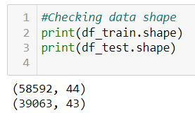
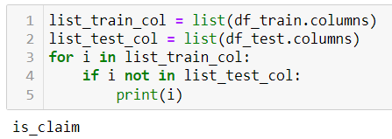
Preliminary observations and data cleaning
There are two data sets given ‘train.csv’ and ‘test.csv’
One column is missing in the test.csv
Columns of both data set is compared and it identified that target variable is missing in the test data.
So only train data is considered for the model building and performance evaluation
For final prediction test data set can be used.
There are 44 variables and 58592 samples in the train.csv data set
Is_claim is target variable and we need to predict claim based other 43 variables.
So Is_claim can be considered as independent /target variable and others can be considered a depended variable for model.
Is_claim contains two values ‘1’, ‘0’ So it can be considered as a binary classification problem, 0 represents the policy will not claim and 1 represents the policy will be claimed.

Slide 5
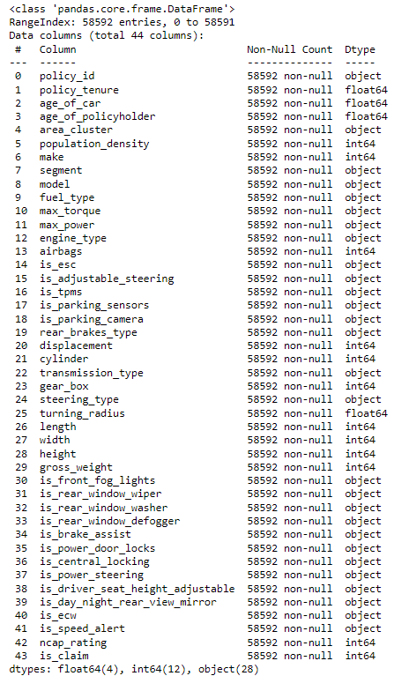
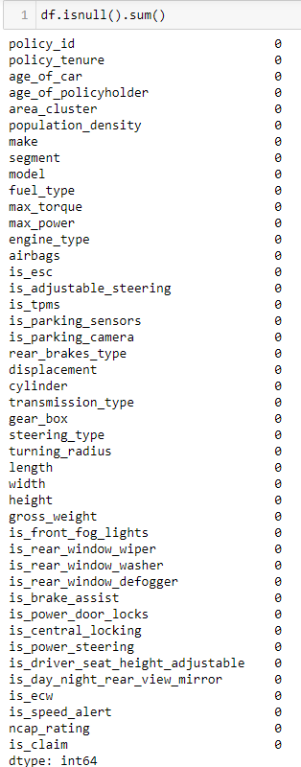

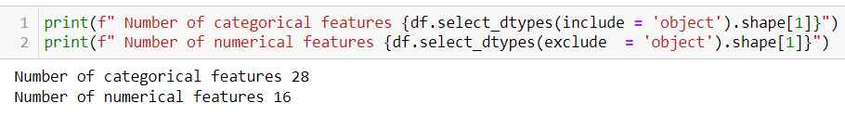
Preliminary observations and data cleaning
Data contains 28 categorical features and 16 numerical features
Out of 16 numerical values 4 is float and 12 is int64
No null values are present in the data set
No duplicate values re present in the data set.
So there is no data cleaning activity need to perform.
Policy id will not used in model building and it can be dropped.
All other features were considered for model building

Slide 6
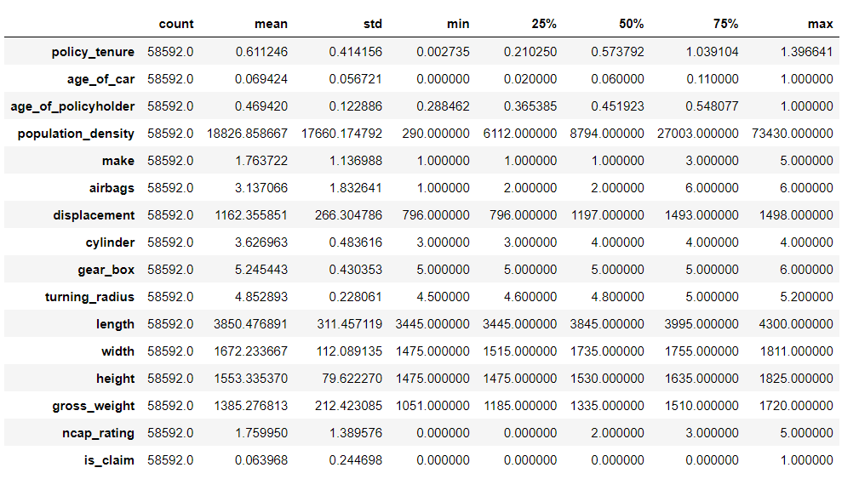
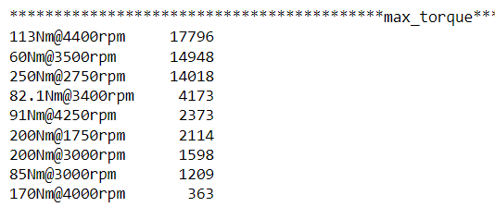
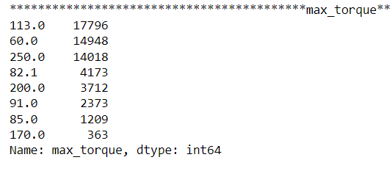
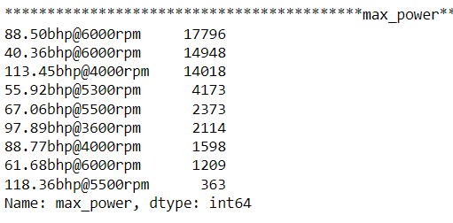
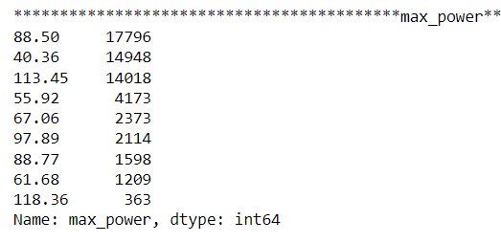
Exploratory Data Analysis (EDA)
Policy id column is dropped before EDA
Categorical and Numerical features analyzed separately.
Outliers are checked in the numerical features most of the features mean and mode values are in same range and no outlier is detected .
Categorical values are analyzed with value counts of each feature.
It is observed that max torque and max power can be converted to numerical values by removing rpm and extracting exactly Torque and bhp values. It was achieved by lambda function .

Slide 7
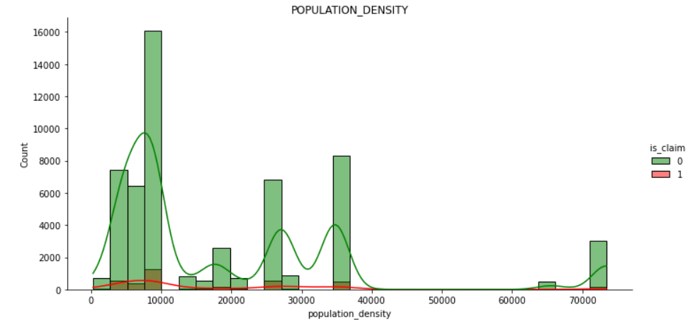
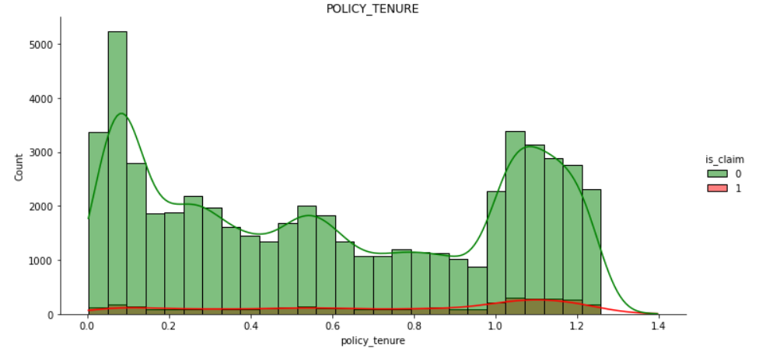
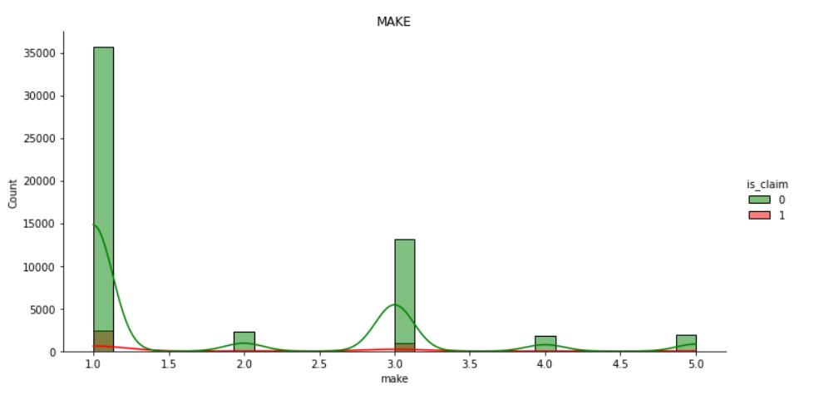
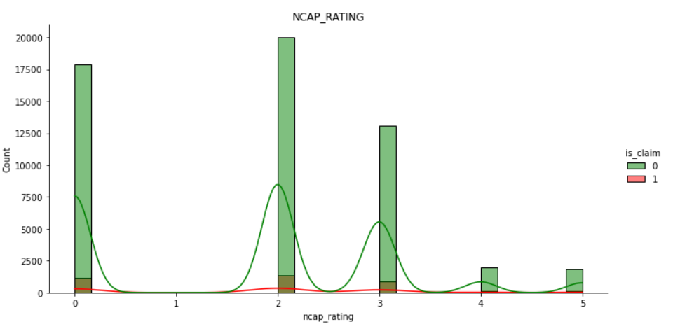
Exploratory Data Analysis (EDA)
Few observation from EDA
Areas with population density 10k have more policies and more claims.
Make one has more policies and more claims as well
Most of people select policy tenure of 1 to 1.2 and also more claim from these policies
Claim for vehicles with NCAP rating 1,2,3 id more comparted with 4 and 5 . May be due to better safety features

Slide 8
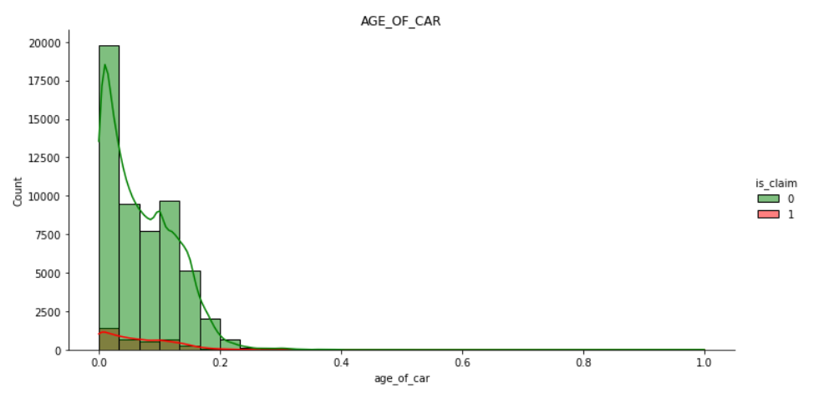
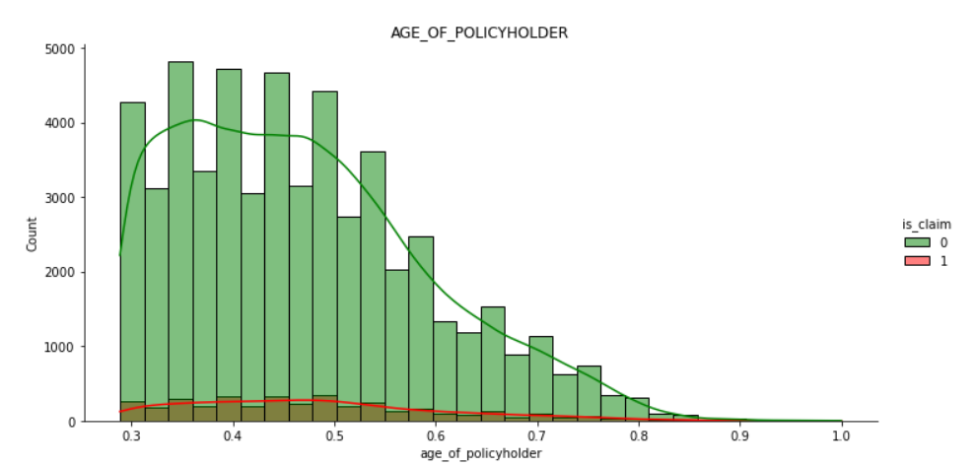
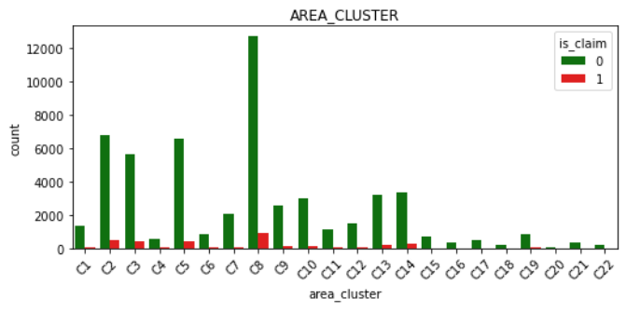
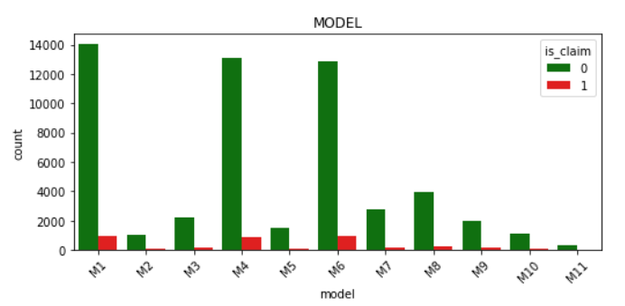
Exploratory Data Analysis (EDA)
Cars with less age has more policies and more claim, May due to accidents in learning period
Lesser the age of policy holder there is more chance of claims.
Area cluster C8 has more policies and more claims.
Model M1,M4 and M6 had more policies and more claims.

Slide 9
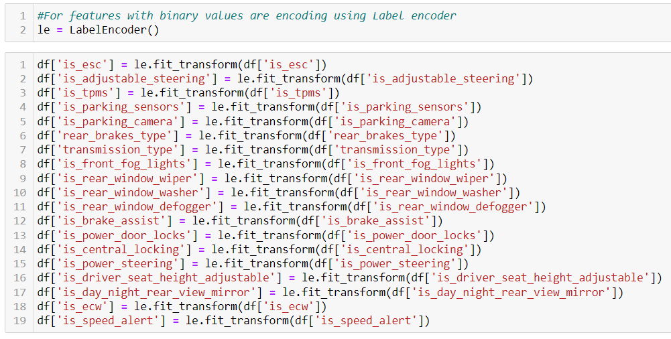
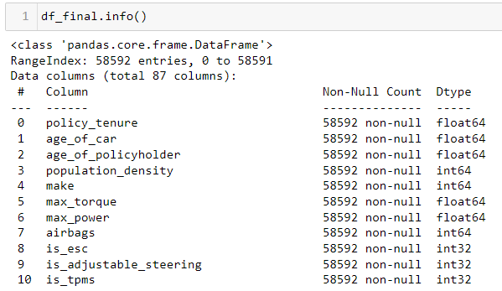
Data Encoding
Encoding is a technique of converting categorical variables into numerical values so that it could be easily fitted to a machine learning model.
Categorical variables with binary values are encoded with Label encoder
Categorical variables with more the two values are encoded with get dummies
So the variables for final data became 87
Dimensionality reduction is checked to reduce the number of variables
Correlation between the variables are checked using corelation matrix

Slide 10
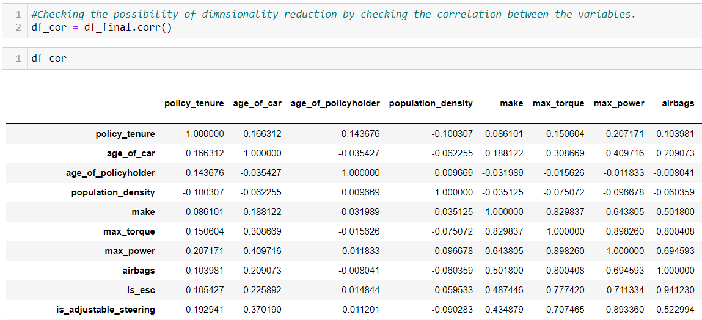
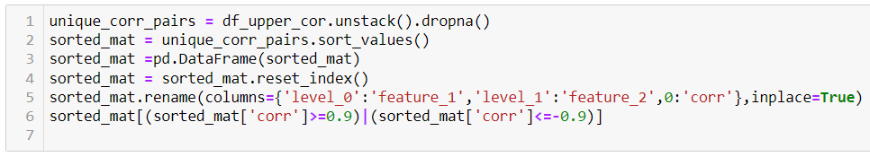
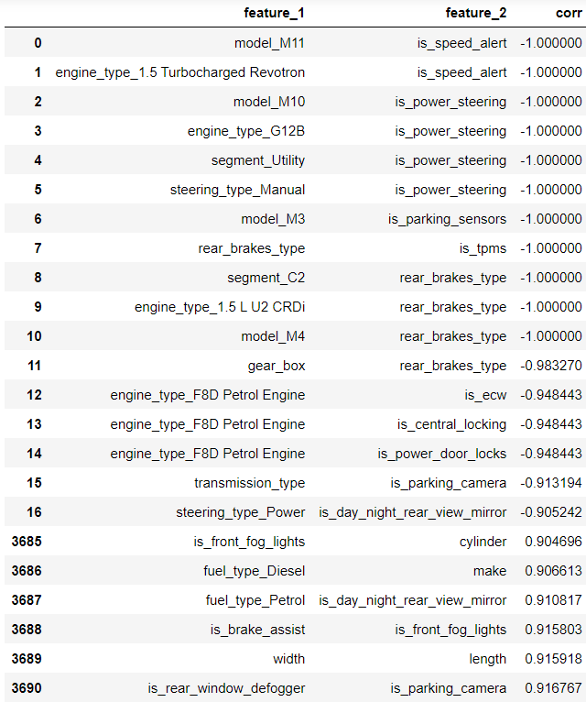
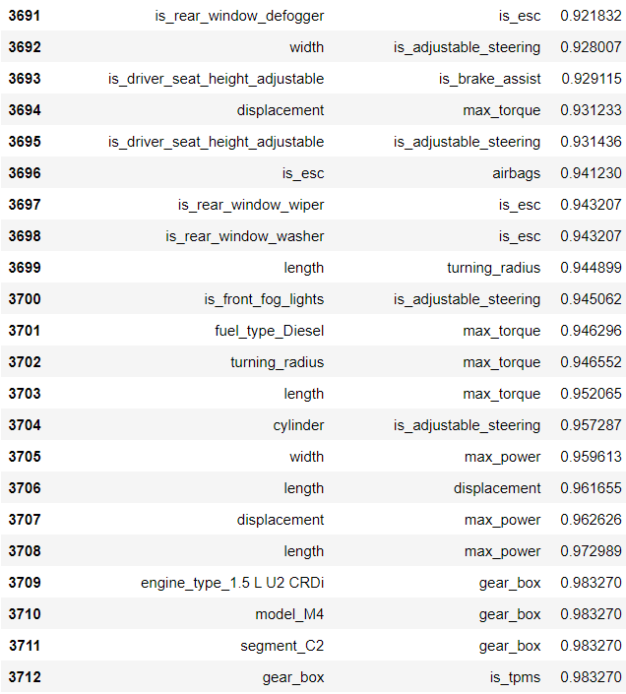
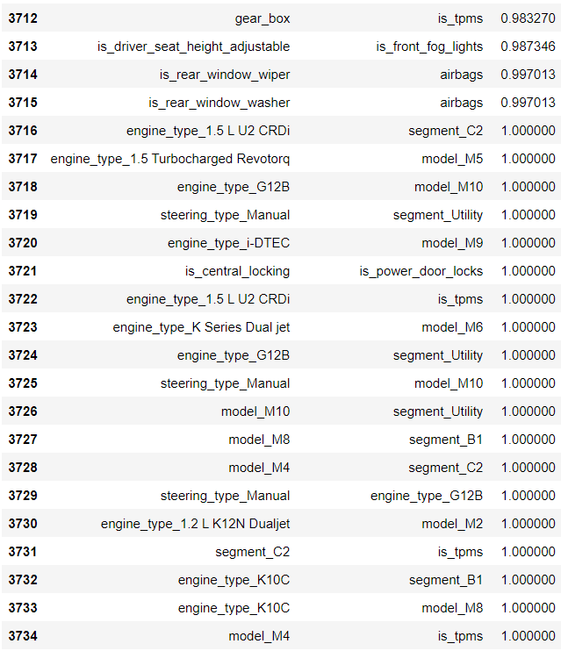
Dimensionality reduction by checking correlation.
Correlation between the variables are checked using corelation matrix
Upper correlation matrix is created and the using unstack new data frame is prepared with features correlation values.
Correlated features with Pearson correlation coefficient value >=0.9 and <= -0.9 are identified and sorted.
But it is observed that there is no logical correlation between the identified features.
Example gearbox and tyre pressure monitoring system having correlation coefficient value 0.983.It is not logically correlated
So it is decided not to drop any features and include all the features for model building

Slide 11
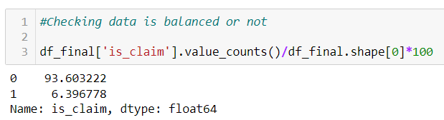
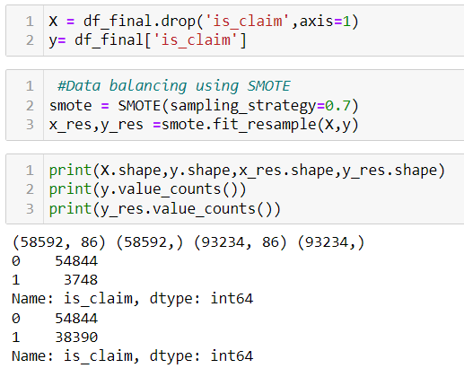
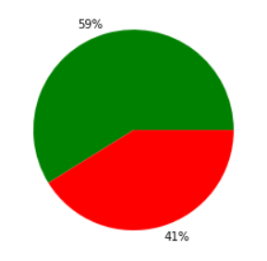
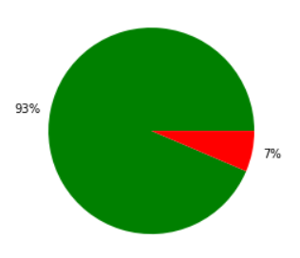
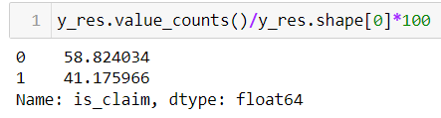
Data Balancing by Over sampling
Imbalanced data refers to those types of datasets where the target class has an uneven distribution of observations, i.e one class label has a very high number of observations and the other has a very low number of observations
The target variable is checked and it is identified that data is highly imbalanced.
It is checked using thumb rule : whether minor data x 2 >= major data
93% values is ‘0’ and represents do not claim policy and 7 % is ‘1’ and represents claim policy.
If we build model based on this the model will be biased .
Data balancing is done using oversampling technique (SMOTE)
Test train is split is done with 80% train sample and 20% test sample.

Slide 12
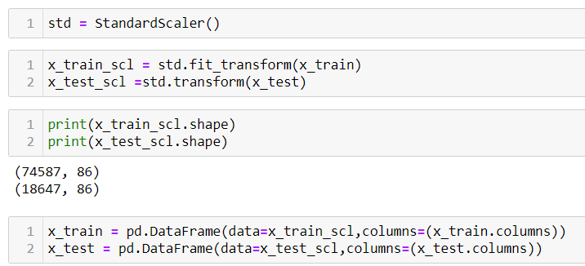
Feature scaling
Feature scaling is the process of normalizing the range of features in a dataset.
Policy claim datasets contains features that are varying in degrees of magnitude, range, and units. Therefore, in order for machine learning models to interpret these features on the same scale, we need to perform feature scaling.
It can be done with standard scalar (converting data to standard normal distribution)
Train data is standardized using fit and transform and test data using only transform. So that test data will not learn any mean and SD values.
This data is used to build multiple models

Slide 13
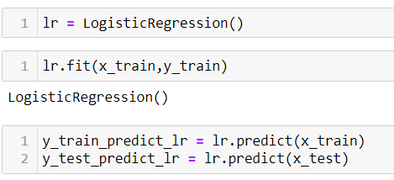
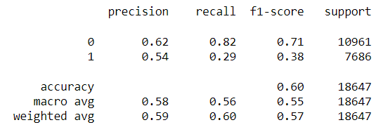
Machine learning Model building
1.Logistic regression
Logistic regression is one of the most popular Machine Learning algorithms, which comes under the Supervised Learning technique.
It is used for binary classification model, As we have binary target value we could use this for model building.
Independent variables and target variable of train data set is fitted to linear regression model.
Target variable is predicted using the test data set and model .Classification report is prepared using predicted data set and actual test data set of target variable.
From classification report it is observed that model
accuracy score - 60%
Recall score – 29%
Precision score – 54%

Slide 14
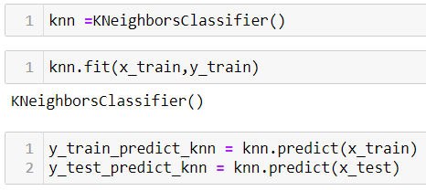
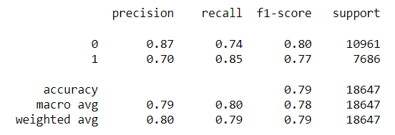
Machine learning Model building
2.K-Nearest Neighbour (KNN)
K-Nearest Neighbour is one of the simplest Machine Learning algorithms based on Supervised Learning technique.
K-NN algorithm assumes the similarity between the new case/data and available cases and put the new case into the category that is most similar to the available categories
Independent variables and target variable of train data set is fitted to K-Nearest Neighbour model.
Target variable is predicted using the test data set and model .Classification report is prepared using predicted data set and actual test data set of target variable.
From classification report it is observed that model
accuracy score - 79%
Recall score – 85%
Precision score – 70%

Slide 15
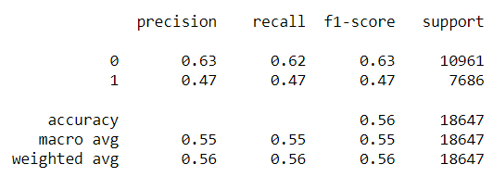
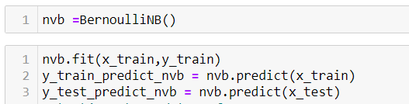
Machine learning Model building
3.Naïve Bayes Classifier
Naïve Bayes algorithm is a supervised learning algorithm, which is based on Bayes theorem and used for solving classification problems.
Naïve Bayes Classifier is one of the simple and most effective Classification algorithms which helps in building the fast machine learning models that can make quick predictions. It is a probabilistic classifier, which means it predicts on the basis of the probability of an object.
BernoulliNB is used as the target variable is binary. Independent variables and target variable of train data set is fitted to Naïve Bayes model.
Target variable is predicted using the test data set and model .Classification report is prepared using predicted data set and actual test data set of target variable.
From classification report it is observed that model
accuracy score - 56%
Recall score – 47%
Precision score – 47%

Slide 16
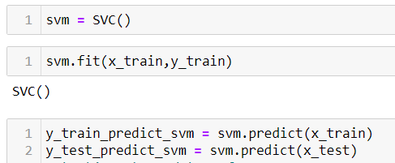
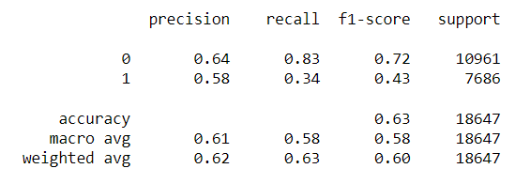
Machine learning Model building
4. Support Vector Machine
Support Vector Machine or SVM is one of the most popular Supervised Learning algorithms, which is used for Classification as well as Regression problems. However, primarily, it is used for Classification problems in Machine Learning.
The goal of the SVM algorithm is to create the best line or decision boundary that can segregate n-dimensional space into classes so that we can easily put the new data point in the correct category in the future. This best decision boundary is called a hyperplane.
Independent variables and target variable of train data set is fitted to Support Vector Machine model.
Target variable is predicted using the test data set and model .Classification report is prepared using predicted data set and actual test data set of target variable.
From classification report it is observed that model
accuracy score - 63%
Recall score – 34%
Precision score – 58%

Slide 17
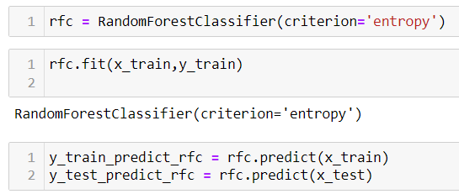
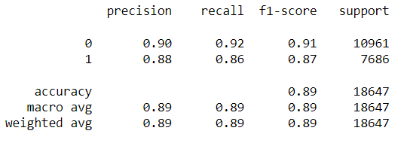
Machine learning Model building
5. Random Forest Classifier
Random Forest is a popular machine learning algorithm that belongs to the supervised learning technique. It is based on the concept of ensemble learning, which is a process of combining multiple classifiers to solve a complex problem and to improve the performance of the model.
As the name suggests, "Random Forest is a classifier that contains a number of decision trees on various subsets of the given dataset and takes the average to improve the predictive accuracy of that dataset." Instead of relying on one decision tree, the random forest takes the prediction from each tree and based on the majority votes of predictions, and it predicts the final output.
Independent variables and target variable of train data set is fitted to Random Forest model.
Target variable is predicted using the test data set and model .Classification report is prepared using predicted data set and actual test data set of target variable.
From classification report it is observed that model
accuracy score - 89%
Recall score – 86%
Precision score – 88%

Slide 18
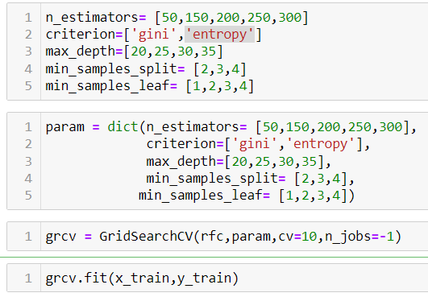
Machine learning Model building
5. Random Forest Classifier
Out of all the models Random forest classifier giving the best Accuracy, Precision and Recall .
Hyperparameters in Machine learning are those parameters that are explicitly defined by the user to control the learning process. The process of selecting the best hyperparameters to use is known as hyperparameter tuning,
Hyper parameter tuning is tried to get the best parameters for Random forest classifier.
It is done with the help of GridSearchCV
The simulation is tried multiple times , due to hardware issues the simulation is stopped in between.
Still by adding the values individually and running the model ,it is observed that criterion='entropy’ giving a slight improvement in the precision and recall.

Slide 19
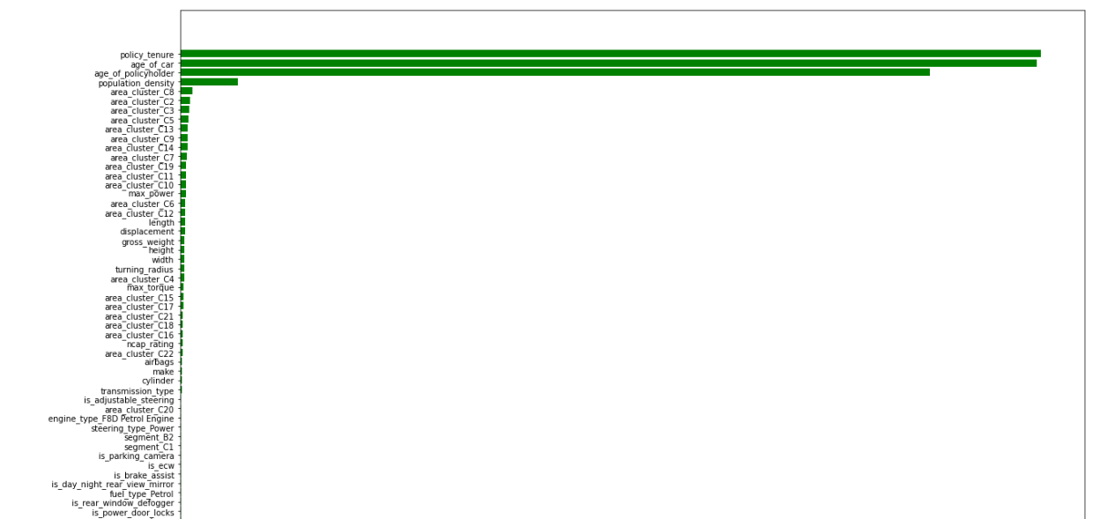
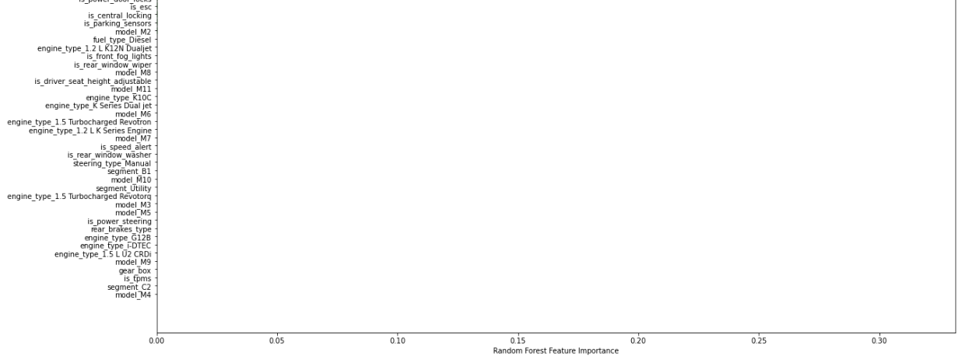
Machine learning Model building
Variable/Feature importance
Based on any of the splitting criteria , the feature reducing the impurity maximum is the most important feature/variable
Feature importance is performed and identified the most important features from Random forest model.
First 26 important features are identified an listed below.
Random forest model again run with 38 important features , but it was giving same performance scores
1.policy_tenure
2.age_of_car
3.age_of_policyholder
4.population_density
5.area_cluster_C8
6.area_cluster_C2
7.area_cluster_C3
8.area_cluster_C5
9.area_cluster_C13
10.area_cluster_C9
11.area_cluster_C14
12.area_cluster_C7
13.area_cluster_C19
14.area_cluster_C11
15.area_cluster_C10
16.max_power
17.area_cluster_C6
18.area_cluster_C12
19.length
20.displacement
21.gross_weight
22.height
23.width
24.turning_radius
25.area_cluster_C4
26.max_torque

Slide 20
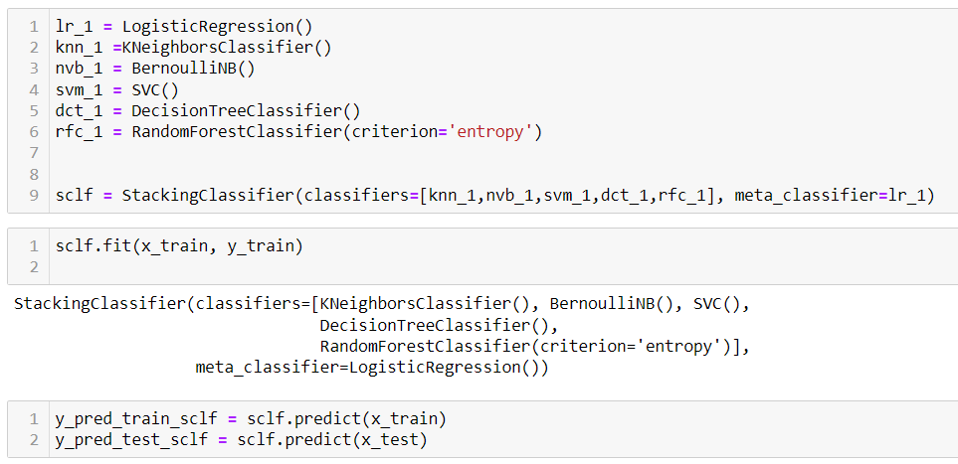
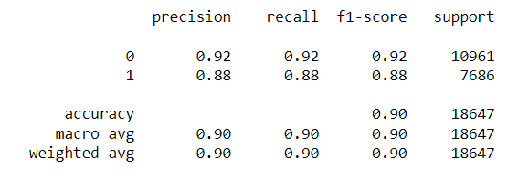
Machine learning Model building
6. Stacking in Machine Learning Models
There are many ways to ensemble models in machine learning, such as Bagging, Boosting, and stacking. Stacking is one of the most popular ensemble machine learning techniques used to predict multiple nodes to build a new model and improve model performance.
Stacking enables us to train multiple models to solve similar problems, and based on their combined output, it builds a new model with improved performance.
Stacking is a way of ensembling classification or regression models it consists of two-layer estimators. The first layer consists of all the baseline models that are used to predict the outputs on the test datasets. The second layer consists of Meta-Classifier or Regressor which takes all the predictions of baseline models as an input and generate new predictions.
K-neighbors Classifier, BernoulliNB, SVC, Decision Tree Classifier and Random Forest Classifier are considered as baselined models and Logistic Regression considered as metamodel
Independent variables and target variable of train data set is fitted to stacking model.
Target variable is predicted using the test data set and model .Classification report is prepared using predicted data set and actual test data set of target variable.
From classification report it is observed that model
accuracy score - 90%
Recall score – 88%
Precision score – 88%

Slide 21
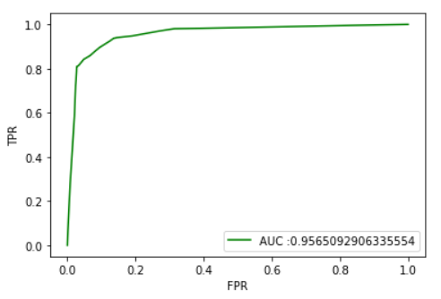
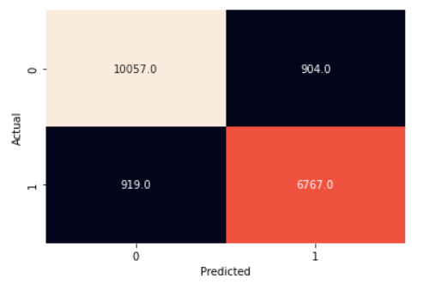
Model performance evaluation and conclusion
Out of all the models Stacking classifier giving the higher performance. Slightly higher performance compared to Random forest
Model evaluation for stacking model is done with confusion matrix and ROC_AUC
From Confusion matrix the below values can be concluded
True Positive (TP) = 6767
True Negative (TN) = 10057
False Positive (FP) = 904
False Negative (FN)= 919
AUC score value is 0.96

Slide 22
Conclusion
Out of all the models Stacking classifier model giving the best performance and it is proposed for the insurance claim prediction model.
Random forest model is also giving the performance near to stacking model.
Stacking classifier Model can be deployed for car insurance claim prediction and as per model evaluation results it should give 90% accuracy.

Slide 23
THANK YOU…!!

